Slide 3
Suriname
Diverse ethnic groups (6 major ones origin in different stages)
Languages:
Dutch (official)
Sranan (lingua franca)
17+ languages

Slide 4
Ethnic Diversity

Slide 5
1517 Trans Atlantic Slave Trade 1863/73

Slide 6
This massive legalized human trafficking system sparked the genesis of a new socioeconomic society within the Caribbean and the Americas, namely,
a “plantation society.”

Slide 7
Plantation Society
Europeans
Colored (mix ethnicities)
Enslaved Africans (cheap labor)
Cheap labor from enslaved persons
All produced goods (cotton, tobacco, and sugar) were transported to Europe so that they could have trade power with Asia, the East, and the rest of Europe.
3 imperatives

Slide 8
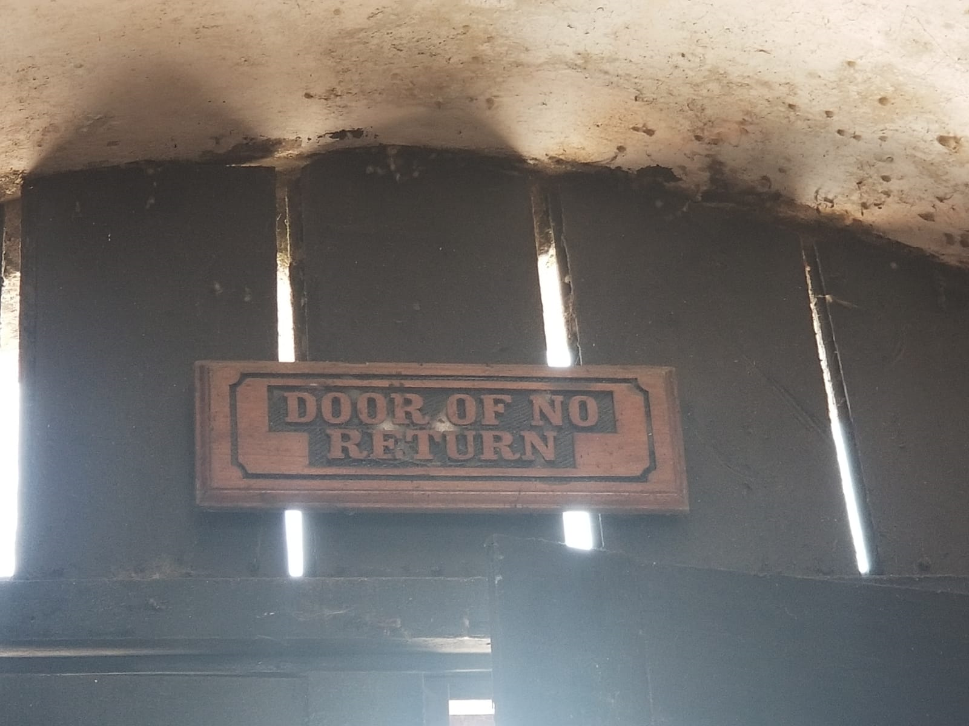
1st Imperative : Uprootedness and displacement
Disconnection with land and ancestry
disorientation and distorts self-worth and a sense of belonging.
This was calculated denigration and deliberate disorientation to erase the memory of Africa (William Watty, 1982)

Slide 9
2nd Imperative: Division
Divide and rule strategy
Division of families and tribes
Blacks policing their own communities for their white masters (Basjas and “sell-outs”)
it is impossible to inflict violence upon a community and still be part of it.

Slide 10
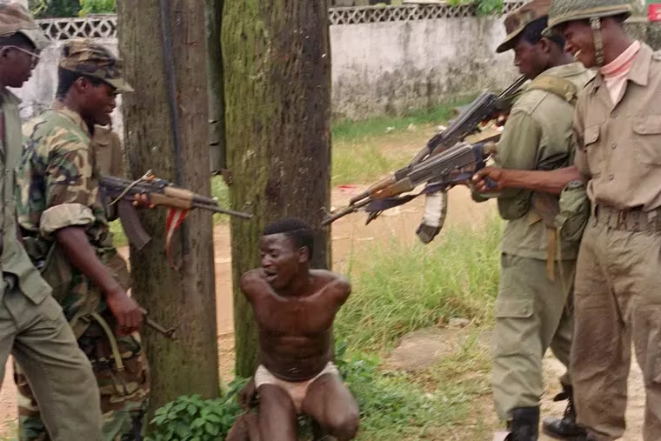
The war in Cameroon
The war in Liberia

Slide 11
3rd imperative: uniformity as success

Slide 12
Success is becoming like the master
Clothing (appropriate attire)
Owning slaves
Despised their own people, community and their own skin

Slide 13
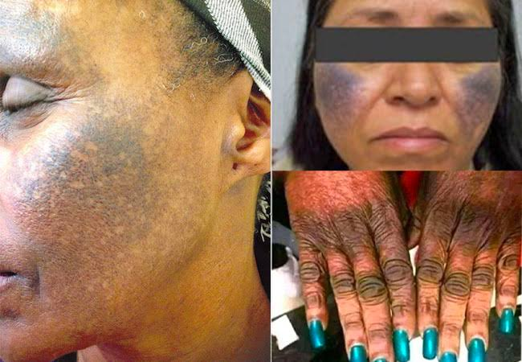
Bleaching

Slide 14
What does this have to do with the church?

Slide 15
The Church as agent of the plantation society (Facilitation of Evil)
The church
Cape Coast white Castel, Ghana

Slide 16
In the Caribbean,
Christianity came with and enabled slavery

Slide 17
the Slave Bible

Slide 18
The “Slave Bible” mentally
Not read or discuss certain Bible Texts in Church
Lots of Pastor or church leaders don’t have or seek theological education (passion, knowledge and wisdom)
Maintaining the status quo (importation theology)
Eroding believers of their culture and dignity
Reading the Bible with an individualistic and capitalistic mindset (making the church a private business)

Slide 19
What is the role of the church?
Dissect your community or society first. Why are things the way you are today? (understand it, locate yourself in it, and appreciate the work done before)
Develop ways in which you can:
Resist the status quo through intentional action and speech
Inspire the current and next generation (hope or horizon)

Slide 20
The role of the church???
Not instead of….., but in addition to…
Change the narrative of Black people (we are created in God’s image and likeness – uplift black excellence)
Seriously, embrace Diakonia as part of its being (soup kitchens, scholarships, etc.)
Advocacy: call the “sell-out” to account. Call for justice!!! (the Prophetic voice)

Slide 21
The church must be an agent of God’s Kingdom
For the kingdom of God is not food and drink but
righteousness and peace and joy
in the Holy Spirit.
Romans 14: 17

Slide 22
Questions and Remarks

